Slide 1
Secure Network Access Control
Learning Outcomes:
Network Security Design for Threat Defense: Cisco security framework to protect networks from evolving cybersecurity threats.
Next-Generation Endpoint Security: Security components such as next-generation firewalls, Web Security Appliance (WSA), and Email Security Appliance (ESA) that are part of the Cisco security framework to protect endpoints from threats and attacks.
Network Access Control (NAC): Technologies such as 802.1x, MAC Authentication Bypass (MAB), Web Authentication (WebAuth), TrustSec and MACsec to enforce network access control.

Slide 2
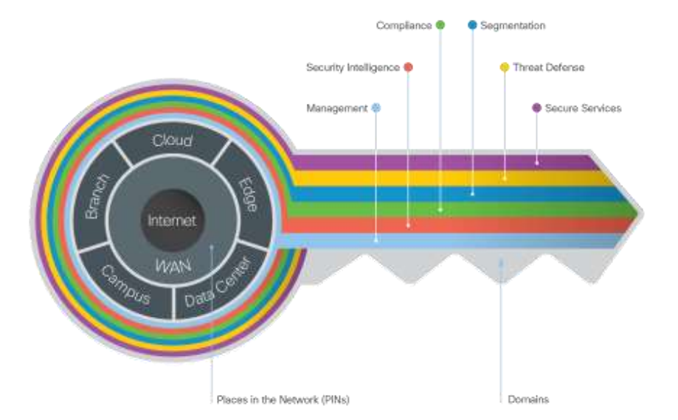
1. Network Security Design for Threat Defense (Cisco SAFE – Secure Architecture for Everyone)

Slide 3
1. Network Security Design for Threat Defense (Cisco SAFE – Secure Architecture for Everyone)
Places in Networks (PIN) of SAFE Branch, Campus, Data center, Edge, Cloud, Wide Area Network (WAN)
Security Domains : Management, Security Intelligence, Compliance, Segmentation, Threat Defense, Secure Services
Attack Continuum: Before, During and After attack

Slide 4
a) Places in Networks (PIN) of SAFE
Branch
High vulnerability level, low criticality level
Threats include endpoint malware, Wireless infrastructure exploits (rogue AP, MitM), malicious client activity and exploitation of trust.
Campus
Medium vulnerability and criticality infrastructures
Threats include phishing, web-based exploits, unauthorized network access, malware propagation and botnet infestation.
Data center
Least vulnerable but most critical
Threats include data extraction, malware propagation, unauthorized network access (application compromise), botnet infestation (scrumping), data loss, privilege escalation, and reconnaissance

Slide 5
a) Places in Networks (PIN) of SAFE
Edge
Most Vulnerable PIN
Threats include web server vulnerabilities, distributed denial-of-service (DDoS) attacks, data loss, and MitM attacks.
Cloud
Low level of vulnerability and criticality, due to SLA’s with cloud provider
Threats include web server vulnerabilities, loss of access, data loss, malware, and MitM attacks
Wide Area Network (WAN)
High Vulnerability, low criticality level
Connects PINs together, therefore challenging task to manage security
Threats include malware propagation, unauthorized network access, WAN sniffing, and MitM attacks.

Slide 6
b) Security Domains
Management: Devices and system management using centralized services
Security Intelligence: Dynamic detection of emerging threats and malware
Compliance: Compliance such as PCI DSS 3.0 and HIPAA
Segmentation: Establishing boundary for data and users
Threat Defense: Visibility into most dangerous cyber threat through network telemetry, file reputation and contextual information.
Secure Services: provide technologies such as ACL, VPN and encryption for services such as applications, wireless and collaboration.

Slide 7
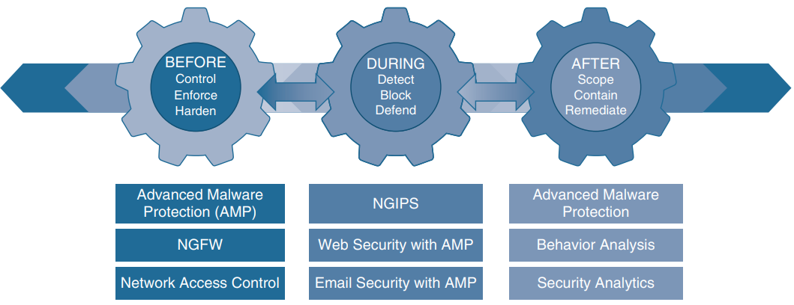
c) Attack Continuum
Before
Know your devices that need to be protected
Identify targets
Establish policies and implement risk reduction techniques
next-generation firewalls, network access control, network security analysis(IDS), and identity services can be utilized.

Slide 8
c) Attack Continuum
During
Abilities and Actions
Threat/Attack analysis and response
IPS, NGFWs, malware protection and Email & Web security appliances can be utilized.
After
Ability to detect, contain and remediate
Reflection and lesson learned
Cisco Advanced Malware Protection, NGFWs, and Stealthwatch can be utilized

Slide 9
2. Next-Generation Endpoint Security
Cisco Talos : Threat Intelligence research group.
Cisco Threat Grid: Protects against malware using sandbox and threat intelligence.
Cisco Advanced Malware Protection (AMP): Malware analysis and protection that goes beyond point in time.
Cisco AnyConnect: A modular VPN client that can map VPN posture and ISE posture.
Cisco Umbrella: Cloud service with DNS intelligence to block requests to malicious domains, urls or IPs.
Web Security Appliance (WSA): Web gateway that blocks malware from suspicious and legitimate websites
Email Security Appliance (ESA): Secure email and combat email security threats.

Slide 10
2. Next-Generation Endpoint Security
Next Generation Intrusion Prevention System (NGIPS): (Does Deep packet inspection), IPS called Firepower that exceeds Gartner NGIPS specifications
Next Generation Firewall (NGFW) : Stateful packet filtering based on IP headers only (protocol, ports & IP addr.)
Cisco Firepower Management Centre (FMC) : Centralised management platform to aggregate and correlate security events, contextual information and network device performance.
Cisco Stealthwatch (Cisco Secure Network Analytics) : Collector and aggregator of network telemetry data to analyse and monitor threats.
Cisco Identity Services Engine (ISE) : Security policy management platform for both user and device based network access control .
Notes:
Contextual information (user, device, location, time-stamp, application etc)
Cisco Stealthwatch provides observability from the context of network security.

Slide 11
3. Network Access Control (NAC) : 802.1x Components
Port based network access control (PNAC) that provides authentication mechanism for LAN and WLAN devices/users.
Dot1x components:
Extensible Authentication Protocol (EAP) : Message format and framework to provide encapsulated transport of authentication parameters.
EAP Type/Method : Several authentication methods available for EAP
EAP over LAN (EAPoL) : Layer 2 encapsulation protocol used in the first leg of the EAP connection, i.e. between Supplicant and Authenticator.
RADIUS : AAA protocol used in second leg of EAP connection, i.e. between Authenticator and Authentication Server(AS) / Cisco ISE.

Slide 12
3. Network Access Control (NAC) : 802.1x Devices
Supplicant : Endpoint software that provides identity credentials to authenticator. Windows and Mac OS has native application. Cisco AnyConnect Network Access Manager (NAM)
Authenticator : Takes EAPoL packets and encapsulates them into RADIUS packets. Has logical controlled and uncontrolled ports. Controlled port for data transport after successful authentication of supplicant through uncontrolled port. Network access devices such as Switch, APs or WLC.
Authentication Server (AS) : Performs authentication of the endpoint by verifying it’s identity through RADIUS Accept or Deny messages

Slide 13
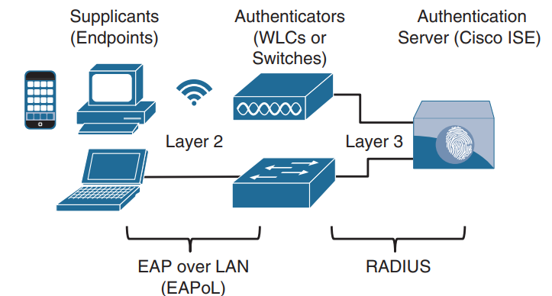
3. Network Access Control (NAC) : Components and Devices

Slide 14
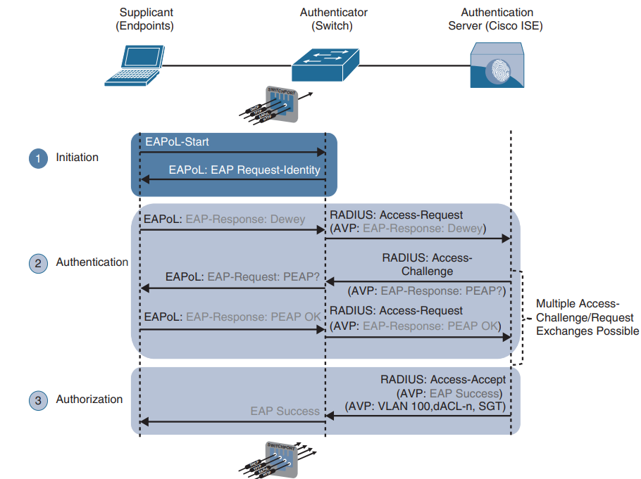
3. NAC: Dot1X Process flow
Step 1: When Authenticator senses port coming up, it sends ‘EAPoL Request-Identity’ message to Supplicant. Alternatively, Supplicant can send ‘EAPoL-Start’ message to Authenticator.
Step 2: Authenticator then relays the EAP message to the Authentication Server (ISE) by extracting from EAPoL frame ‘EAP-Response’ and encoding into RADIUS ‘Access-Request’ Attribute-Value Pair (AVP) until an EAP method is selected by exchanging RADIUS ‘Access-Challenge’ and ‘Access-Request’ messages. Supplicant then authenticates using the selected EAP method with the ISE.
Step3: If authentication is successful, RADIUS ‘Access-Accept’ message is sent from ISE to the supplicant along with other Authorization parameters such as downloadable ACL (dACL), dynamic VLAN(dVLAN) and Security Group Tags (SGT).Authenticator then opens the controlled port for data communication.

Slide 15
3. NAC: EAP Methods
EAP Challenge-based Auth :
EAP-MD5 : Supplicant shares MD5 hash of username/password with ISE to authenticate itself. There is no mutual authentication as supplicant can’t validate ISE.
EAP TLS: Provides mutual authentication with TLS Public Key Infrastructure (PKI). Certificates need to be generated for every supplicant and installed out-of band. Administratively burdensome to implement.
EAP TTLS (Outer) Auth: Create an outer TLS tunnel between supplicant and ISE.
EAP-FAST (EAP Flexible Authentication via Secure Tunneling)
EAP-TTLS (EAP Tunneled TLS)
PEAP (Protected Extensible Authentication Protocol): Also known as EAP in EAP and is mostly used.
EAP Inner Auth: This methods exchange authentication data over an outer methods listed above.
EAP-GTC (EAP Generic Token Card)
MSCHAPv2 (Microsoft Challenge Authentication Protocol)
EAP-TLS
EAP Chaining: It’s a method that supports machine and user authentication in a single outer TLS tunnel.
EAP-FAST supports EAP chaining.
This allows users authenticating with corporate managed devices to be assigned with greater privileges and security posture assessment.
Notes:
EAP TTLS methods(EAP-FAST, EAP-TTLS and PEAP) use one of the inner Authentication methods over an outer TLS tunnel.

Slide 16
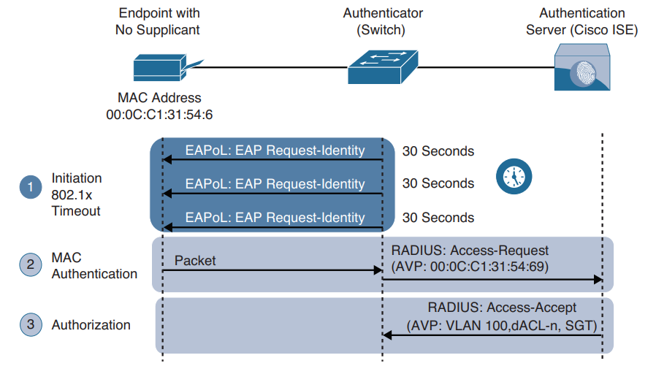
3.NAC: MAB
MAC Authentication Bypass (MAB):
Fallback mechanism to 802.1x, MAB enabled port can be enabled or disabled based on the MAC address of the device that connects to it.
Step 1: As in EAP, a switch sends ‘EAP Request-Identity’ message every 30 seconds. If no reply(timeout) after 3 messages (90 secs), the switch assumes the device does not have supplicant and proceeds to authenticate it using MAB.
Step 2: Switch begins MAB by accepting a packet to learn MAC address of the device. The switch discards the packet after learning the MAC address, which it uses as identity to encapsulate into RADIUS ‘Access-Request’ message.
Step 3: The RADIUS server determines if the endpoint should be granted access and the authorization level. It sends RADIUS ‘Access-Accept’ message along with dACL, dVLAN and SGT tags.

Slide 17
3.NAC: WebAuth
Web Authentication (WebAuth)
Unknown devices can be either assigned to guest VLAN or can be authenticated using WebAuth.
Web Authentication can be used as fallback for guests or devices that cannot perform 802.1x or MAB.
If both MAB and WebAuth are enabled as fallback to dot1x, then it performs MAB first, if not successful then it performs WebAuth.
Unlike MAB, WebAuth is only for users and is not supported to authenticate devices.
Two Types of WebAuth :
Local WebAuth (LWA)
Authenticator (Switch or WLC) hosts the web portal.
Once the user provides username and password, authenticator sends a RADIUS ‘Access-Request’ message to ISE.
The web portal hosted by authenticator is not customizable such as acceptance of End User License Agreement (EULA) page.
LWA only supports ACL assignment and does not support Change of Authorization (CoA) or VLAN assignment.
Centralised WebAuth (CWA) with ISE
Supports CoA for posture profiling, dACL and VLAN authorization options.
Supports advanced options such as client provisioning, posture assessments, acceptable use policies, password changing, self-registration and device registration.
CWA follows different steps than LWA.

Slide 18
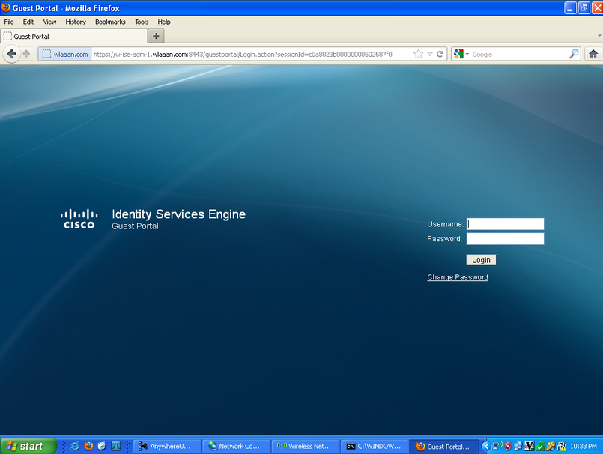
3.NAC: WebAuth
CWA follows below steps:
Device with missing or misconfigured supplicant enters the network.
Switch performs MAB by sending RADIUS ‘Access-Request’ message to ISE.
ISE sends RADIUS result with URL redirection to centralised web-portal hosted on itself.
Endpoint is assigned an IP address, default gateway and DNS server using DHCP.
End user sends credentials using the web-portal, ISE stores the credentials mapped with MAB request sent from the switch.
ISE sends a re-authentication (CoA re-auth) to the switch.
Switch sends new MAB request with same session ID to ISE.
ISE sends final authorization result with relevant access policies such as dACL, dVLAN and SGTs.

Slide 19
3.NAC: FlexAuth
Enhanced Flexible Authentication (FlexAuth):
A 802.1x enabled authenticator device will by default perform 802.1x first then MAB and then WebAuth.
Because of this a user trying to authenticate using WebAuth will have to wait a considerable amount of time.
FlexAuth also known as Access Session Manager is the solution that allows endpoint to try multiple authentication mechanism concurrently.
FlexAuth is a component of Cisco’s integrated access control solution IBNS.
Cisco Identity-Based Network Services (IBNS) 2.0
Integrated end-to-end solution that offers authentication, access control and user policy enforcement.
Combination of below existing solutions:
Enhanced FlexAuth (Session Manager)
Cisco Common Classification Policy Language (C3PL)
Cisco Identity Services Engine (ISE)

Slide 20
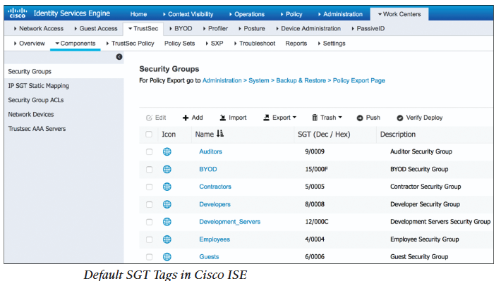
3.NAC: TrustSec
TrustSec
Next generation access control solution that uses Security Group Tag (SGT) tags instead of ACLs and firewall rules.
Unlike ACLs and firewall policies, TrustSec does not ties access policy to the topology (such as permit src ip to dst ip) .
Access policy with TrustSec is based on User group and roles no matter which part of the network the user connects from and what ip address the user is assigned.
Once the user/device is successfully authenticated and authorized through 802.1x, MAB or WebAuth, ISE assigns SGT tags to the endpoint.
Each SGT has name for readability, and has dec/hex value that is actually inserted into frames to identify the SGT.
TrustSec environment performs ingress tagging and egress filtering based on traffic SGT to enforce access policies.
TrustSec environment consists of following components:
Ingress Classification : Assign SGT tags to users, devices or resources at ingress of TrustSec network.
Propagation: Propagation of assigned tags from source to destination TrustSec devices.
Egress Enforcement: Enforcing policies to user traffic as per the SGT policy at egress.

Slide 21
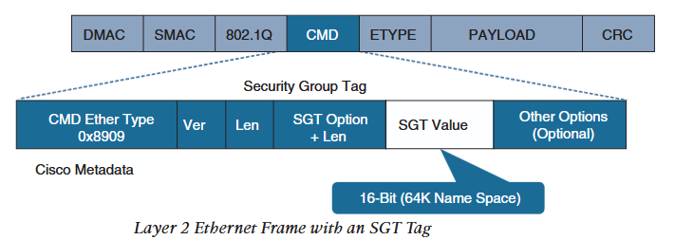
3.NAC: TrustSec
Ingress Classification : Can be done in one of two ways
Dynamic Assignment: Assign dynamically and is downloaded as an authorization option during 802.1x, MAB or WebAuth.
Static Assignment: In environments where 802.1x,MAB or WebAuth is not used dynamic assignment is not possible.
In such cases SGT tags are statically mapped on SGT capable network devices.
Alternatively, ISE can be configured with database of IP to SGT tag that can be downloaded by SGT capable network devices.
Static mapping of SGT tags can be one of the following:
IP to SGT tag
Subnet to SGT tag
VLAN to SGT tag
Layer 2 interface to SGT tag
Layer 3 interface to SGT tag
Port to SGT tag
Port profile to SGT tag.
Propagation: Can be done in one of two ways
Inline (Native) Tagging: Tag propagation happens in data plane where tags are transmitted along with frames.
As tags are inserted into the frame, it is layer 3 independent and not impacted by any routing or firewall policy.
Network devices that do not have ASIC support for TrustSec drops the SGT inserted frame.
In such cases, SGT Exchange Protocol (SXP) is required to propagate the SGT tags.

Slide 22
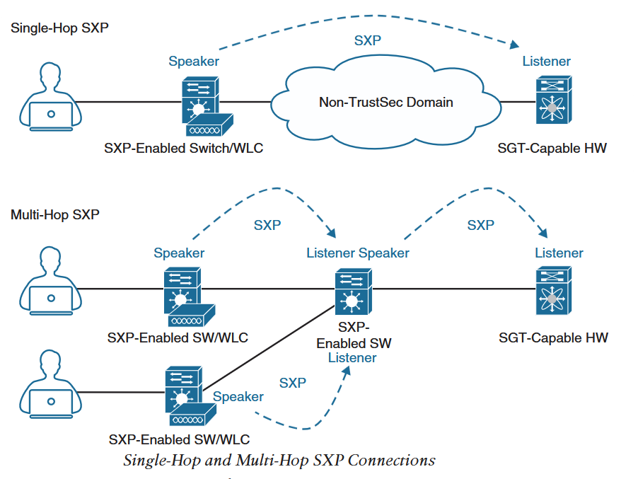
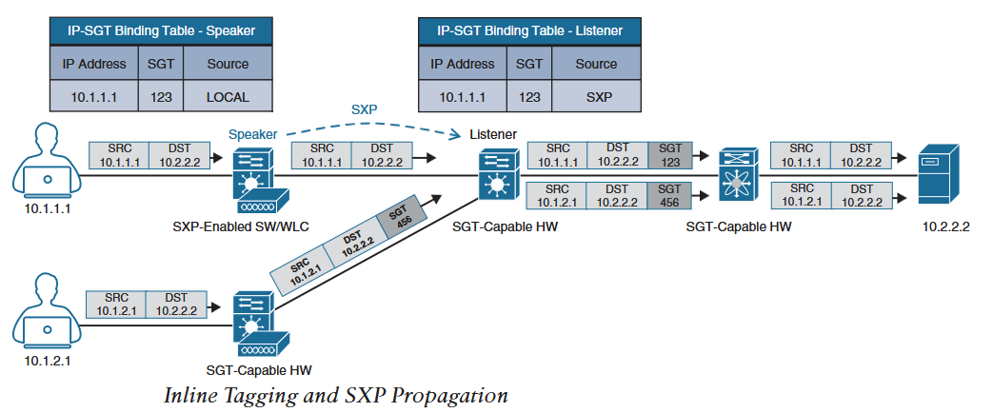
3.NAC: TrustSec
SGT Exchange Protocol (SXP):
TCP based peer-to-peer protocol
Using SXP connection IP-to-SGT mapping is shared between non-inline tagging switches and other network devices.
Non-inline tagging switches enable with SXP has SGT database to enforce policy.
Network device that sends IP-to-SGT binding is called Speaker and one receiving is called Listener.
SXP connection can be single hop or multi-hop as below:
Below diagram shows a switch that do not support inline (native) tagging but is enabled with SXP and another switch that supports native tagging.
SXP Speaker switch forwards the data packet normally and shares IP-SGT binding to next-hop over an SXP connection.
SGT capable switch forwards the packet with SGT inserted natively into the frame.

Slide 23
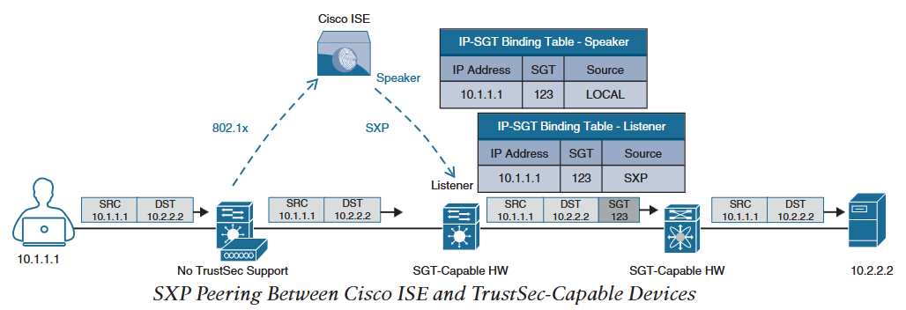
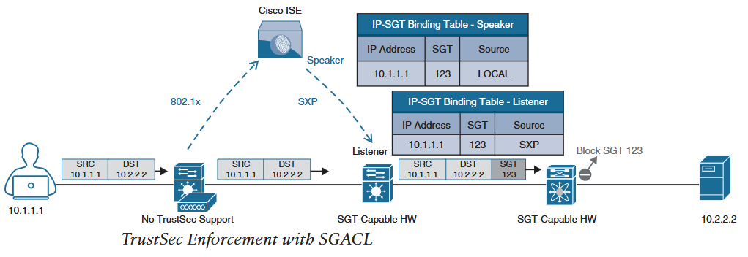
3.NAC: TrustSec
A network device that does not support inline tagging or SXP, forwards traffic normally.
The IP-to-SGT binding is propagated to upstream device through SXP connection between ISE and upstream SGT capable HW.
Security Group ACL (SGACL) : ACL provides filtering based on source and destination SGT.
A SGACL production matrix comprises of source groups and destination groups as rows and columns with permit, deny or a more granular access policy such as permit ftp only as a matrix values.
Egress Enforcement
Enforcing of access policy based on SGT is applied at egress TrustSec device in two ways:
Security Group Firewall (SGFW) : Cisco Firewalls such as ASA and NGFW configured with SGT based policy to enforce access policy.

Slide 24
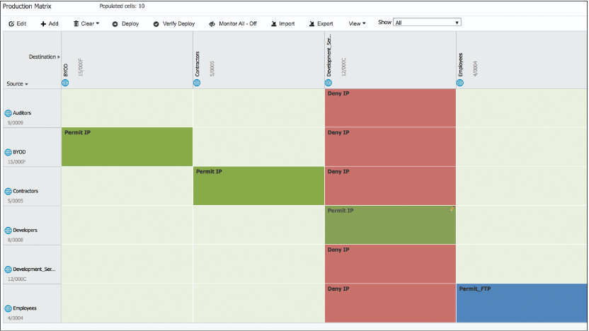
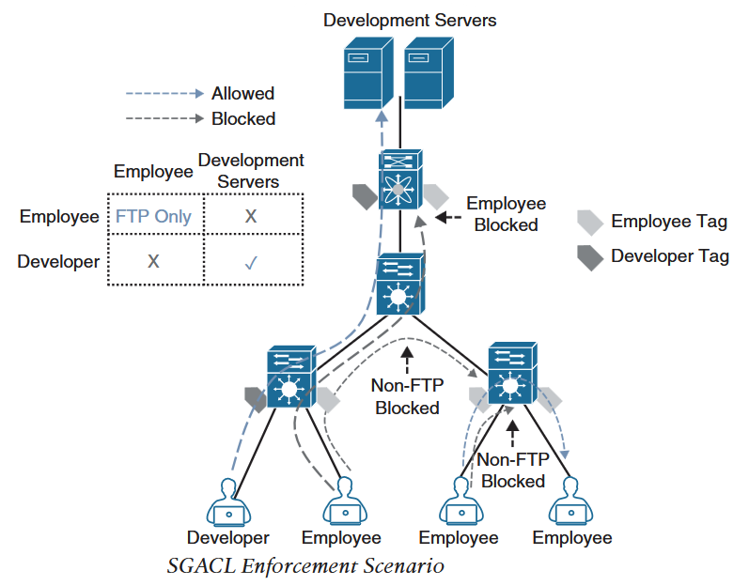
3.NAC: TrustSec
Below picture shows a SGACL production matrix on ISE.
Green/Permit IP is equivalent to permit all, Red/Deny IP is equivalent to deny all, blue is permit FTP only SGACL applied and other light green is default policy that is set in ISE.
Below picture shows a SGACL enforcement.
The matrix shows that only Developer SGT is allowed to Development Servers.
Employee SGT is Blocked to Development Servers.
Employee SGT to Employee SGT is Allowed only FTP traffic and non-FTP is Blocked.

Slide 25
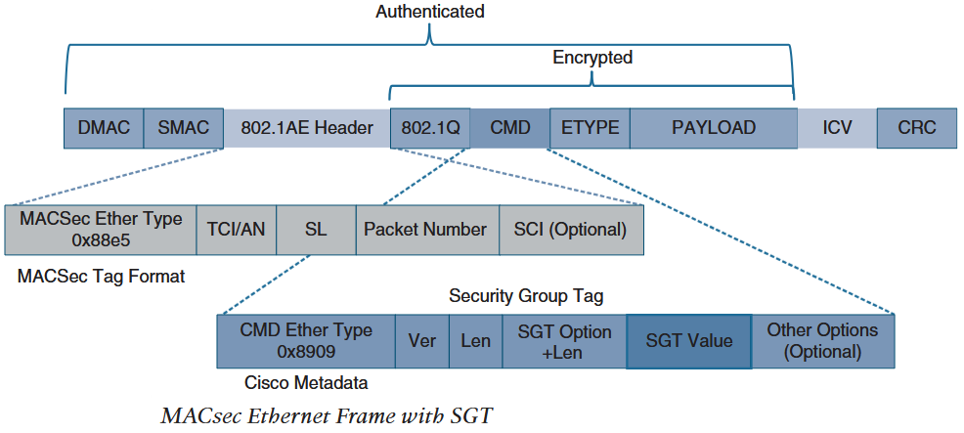
3.NAC: MACSec
IEEE 802.1AE standards-based layer 2 hop by hop encryption method.
Once the user/device is authenticated and applied SGT, MACSec is used to encrypt frames between two adjacent switches interface to interface.
Encryption and decryption of the frames is done by onboard ASICs rather than crypto engine.
Encryption and decryption is performed by each switch on the path to process the frame and inspect SGT and QoS tags.
16-bytes MACSec (802.1AE header) and 16-bytes Integrity Check Value (ICV) is added to ethernet frame that has TrustSec SGT inserted.
The 802.1AE (MACsec) header fields are:
MACSec Ether Type (first 2 octets) : set to 0x88e5 to identify the frame as MACSec.
TCI/AN(3rd octet) :Tag Control Information / Association Number field
SL(4th Octet) : Short Length field, designating the length of encrypted data
Packet Number (5th - 8th octets) : Packet numbers to protect replay attacks and to use as initialisation vector (IV)
SCI (9th - 16th octets) : Secure Channel Identifier
MACsec provide authentication with Galios Method Authentication Code (GMAC) or authenticated encryption with Galios/Counter Mode Advanced Encryption Standard (AES-GCM)

Slide 26
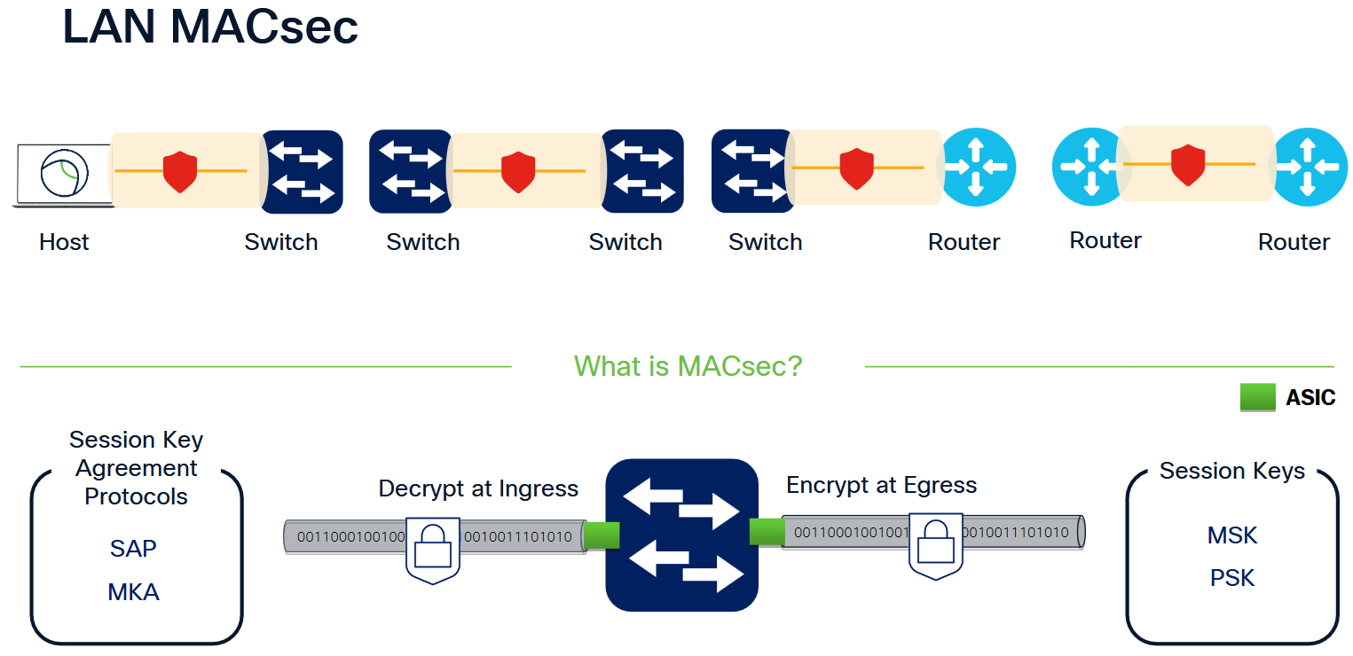
3.NAC: MACSec
Two MACsec keying mechanism are available:
Security Association Protocol (SAP) : Cisco proprietary keying protocol used between Cisco switches.
MACsec Key Agreement (MKA) Protocol : Provides required session keys and manages encryption keys. MACsec encryption with MKA is supported between endpoint and switch as well as between switches.
Downlink MACsec
Encrypted link between Cisco switch and endpoint is known as downlink MACsec.
This requires MACsec capable switch and endpoint.
Encryption on endpoint can be handled by hardware if available or can be done by software such as Cisco AnyConnect using endpoint CPU.
The encryption on endpoint can be forced, optional or no-encryption by switch through manual port configuration or set by ISE dynamically as authorization option.
ISE authorization option for MACsec on endpoint takes preference over manual switchport configuration.
Uplink MACsec
Encrypted link between two switches is known as uplink MACsec
By default uplink MACsec uses SAP for encryption

